Slide 1
How to judge your program: Simplicity? Correctness? Efficiency?
Time → stop watch? → draw graph → ugly graph →
Choice of k … fairness
Choice of n_0 … scalability
Note: solution complexity vs problem complexity

Slide 2
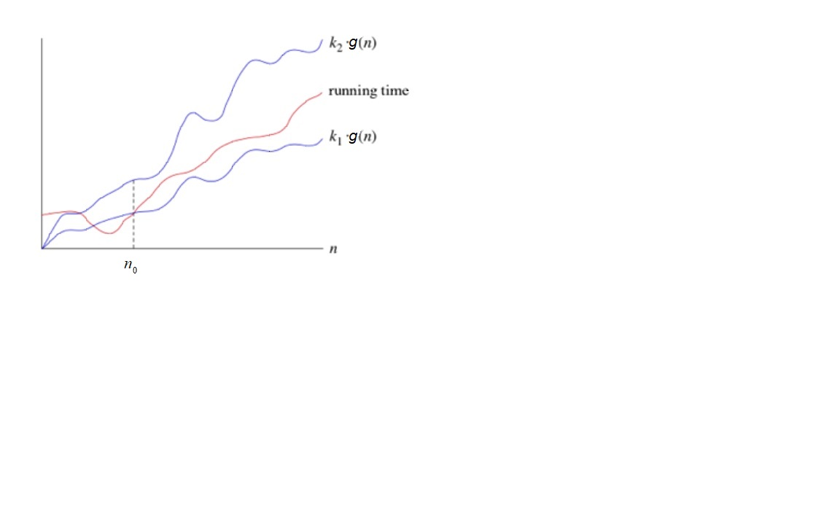
Space / time
f(n)
Notes:
Does not matter when the problem size is small (n_0)
Does not matter when there is a constant speed up (rich vs poor) K_2
f(n) is ugly looking – we want something simpler g(n) … to characterize the nature of f(n)

Slide 3
k₂
g(n)
Upper bound
Time or Space
f(n)
k₁
g(n)
Lower bound
n₀
Input size n
Notes:
Does not matter when the problem size is small (n_0)
Does not matter when there is a constant speed up (rich vs poor) K_2
f(n) is ugly looking – we want something simpler g(n) … to characterize the nature of f(n)

Slide 4
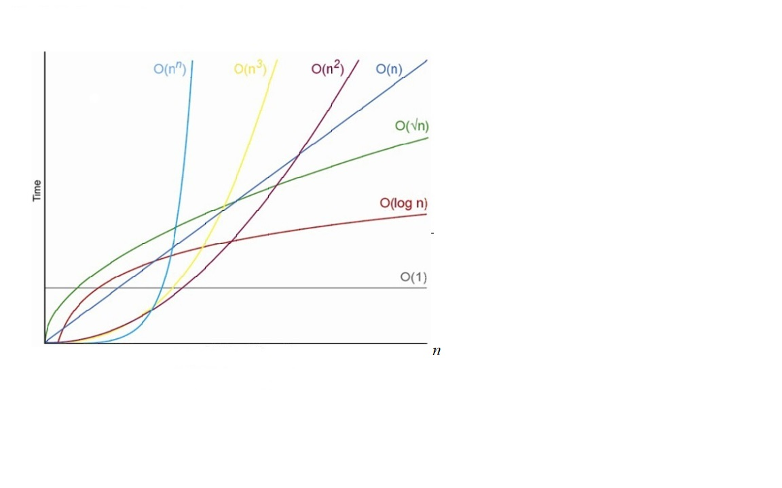

Slide 5
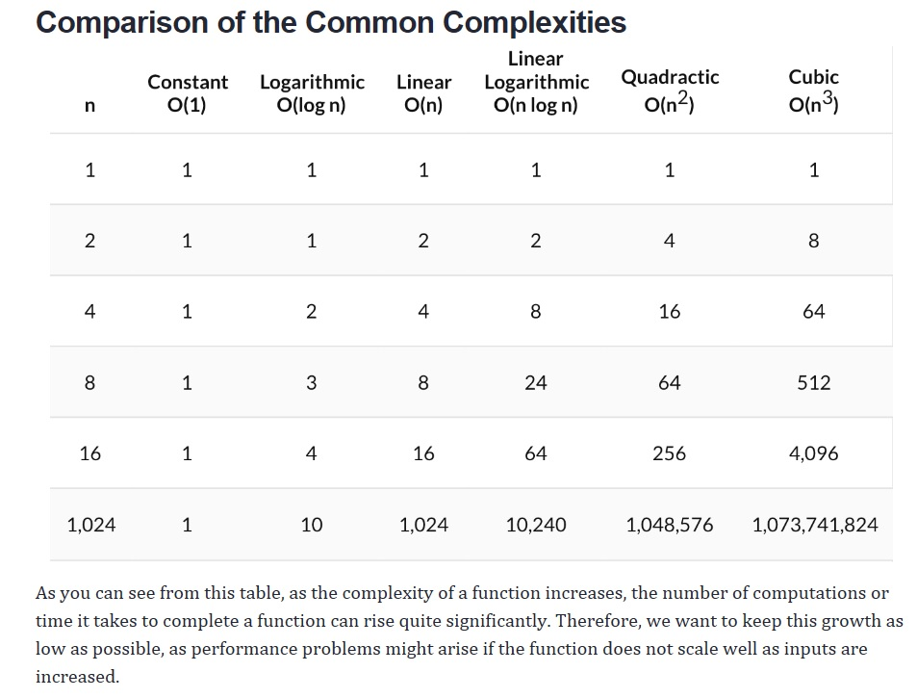

Slide 6
Question 3. recursive version
fact(5)
5 * fact(4) …. O(1)
5 *4 * fact(3)…. O(1)
5 * 4 * 3 * fact(2) … O(1)
5 * 4 * 3 * 2 * fact(1) …O(1)
5 * 4 * 3 * 2 * 1* fact(0) … O(1)
5 * 4 *3 * 2 * 1 * 1 … O(1)
5 * 4 *3 * 2 * 1 … O(1)
5 * 4 *3 * 2 …O(1)
5 * 4 *6 …. O(1)
5 * 24 … O(1)
120 … O(1)

Slide 7
Question 4. iterative factorial
time | fact | i
1 | 1 |  | O(1)
2 | 2 | 2 | O(1)
3 | 6 | 3 | O(1)
4 | 24 | 4 | O(1)
5 | 120 | 5 | O(1)
6 | Return 120 | 6
fact(5)
Going through the loop n-1 times, takes O(n)
Each time it takes constant effort (multiplication)
So, total is O(n) x O(1) = O(n)
Space: only keeping track of product….O(1)

Slide 8

Question 5 (1 of 3)
e is called Euler’s number
e = 2.71828, and is the limit of (1 + 1/n)^{n}

Slide 9

e = $\lim_{n→∞}{e_{n} = }( \sum_{i=0}^{n−1}{ \frac{1}{i!} ) + \frac{1}{n!}}$
= ${ e}_{n−1} +\frac{1}{n!}$

Slide 10
Question 5 (2 of 3)
find_e(5)
1/fact(5) + find_e(4)……O(1)…for checking 5 is not 0, and then to reach the expansion.
1/120 + find_e(4) ….O(n)….this is from fact(5)
1/120 + 1/fact(4) + find_e(3) ….O(1)
1/120 + 1/24 + find_e(3) …. O(n-1)
1/120 + 1/24 + 1/fact(3) + find_e(2) … O(1)
1/120 + 1/24 + 1/6 + find_e(2) … O(n-2)
1/120 + 1/24 + 1/6 + 1/fact(2) + find_e(1)
1/120 + 1/24 + 1/6 + 1/2 + find_e(1)
1/120 + 1/24 + 1/6 + 1/2 + 1/fact(1) + find_e(0)
1/120 + 1/24 + 1/6 + 1/2 + 1/1 + find_e(0)
1/120 + 1/24 + 1/6 + 1/2 + 1/1 + 1
1/120 + 1/24 + 1/6 + 1/2 + 2
1/120 + 1/24 + 1/6 + 2.5
1/120 + 1/24 + 2.6666666666666665
1/120 + 2.7083333333333335
2.716666666666667
→ [ n+(n-1)+(n-2)+(n-3)….+1] + (1+1+1+1+….+1) = (n+1)xn/2 + n = O(n^2) + O(n) = O(n^2)
Notes:
Horizontally …space usage
Vertically….time usage

Slide 11
Question 5 (3 of 3): what-if we swap?
def find_e(n):
if n==0:
return 1
else:
return find_e(n-1) + 1/fact(n)

Slide 12
Question 5 (3 of 3)..cont.
find_e(5)
find_e(4) + 1/fact(5) … O(1) for checking 5 is not 0, and then to reach the expansion
find_e(3) + 1/fact(4) + 1/fact(5) … O(1)
find_e(2) + 1/fact(3) + 1/fact(4) + 1/fact(5)
find_e(1) + 1/fact(2) + 1/fact(3) + 1/fact(4) + 1/fact(5)
find_e(0) + 1/fact(1) + 1/fact(2) + 1/fact(3) + 1/fact(4) + 1/fact(5)
1 + 1/fact(1) + 1/fact(2) + 1/fact(3) + 1/fact(4) + 1/fact(5)
1 + 1 + 1/fact(2) + 1/fact(3) + 1/fact(4) + 1/fact(5) … O(1)
2 + 1/fact(2) + 1/fact(3) + 1/fact(4) + 1/fact(5) … O(2)
2 + ½ + 1/fact(3) + 1/fact(4) + 1/fact(5) … O(3)
2.5 + 1/fact(3) + 1/fact(4) + 1/fact(5)
2.5 + 1/6 + 1/fact(4) + 1/fact(5)
….

Slide 13
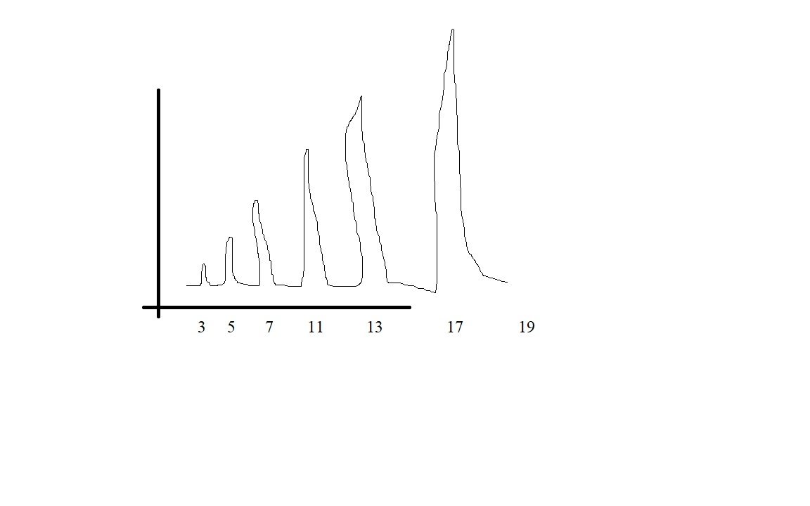
Question 6.
O(n^1.5)

